Slide 1
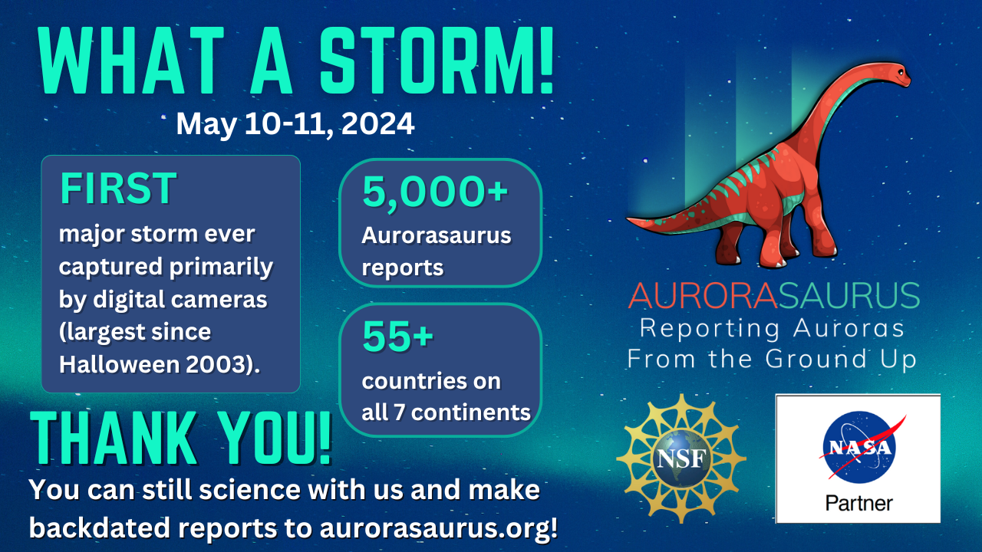
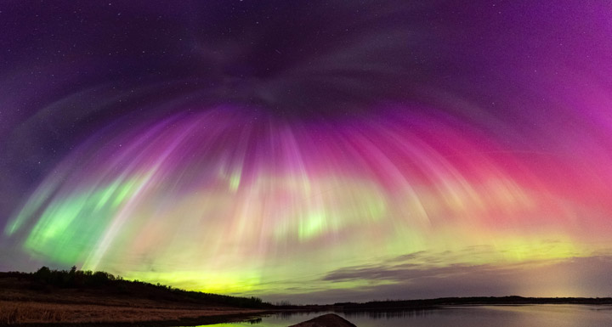
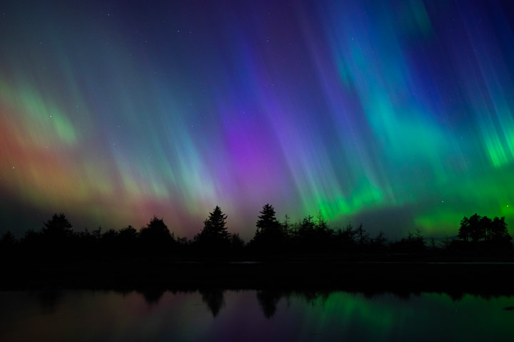
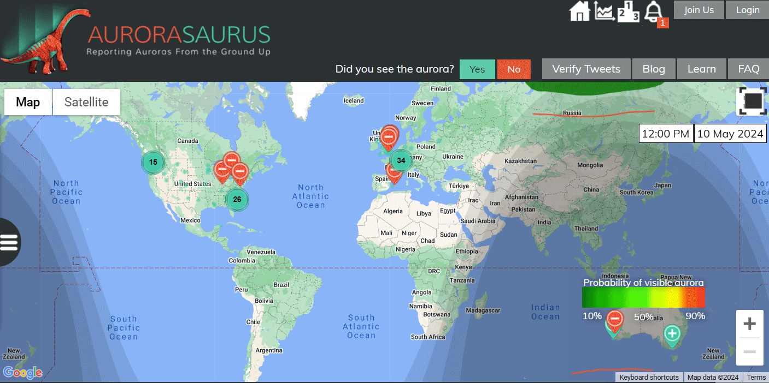
GEM Mini-report: Liz MacDonald, Laura Edson, Francesca di Mare, & more!
“Cameras — even standard cell phone cameras — are much more sensitive to the colors of the aurora than they were in the past. By collecting photos from around the world, we have a huge opportunity to learn more about auroras through citizen science.” - Dr. Liz MacDonald
Photo by Gunjan Sinha, acquired on May 11, 2024, from near Saskatoon in Saskatchewan, Canada, published in NASA Earth Observatory
Photo by Kashmir Wilkinson,
May 11, 2024, from the Olympic Peninsula in Washington, U.S., published in NASA Earth Observatory
Preliminary view

Slide 2
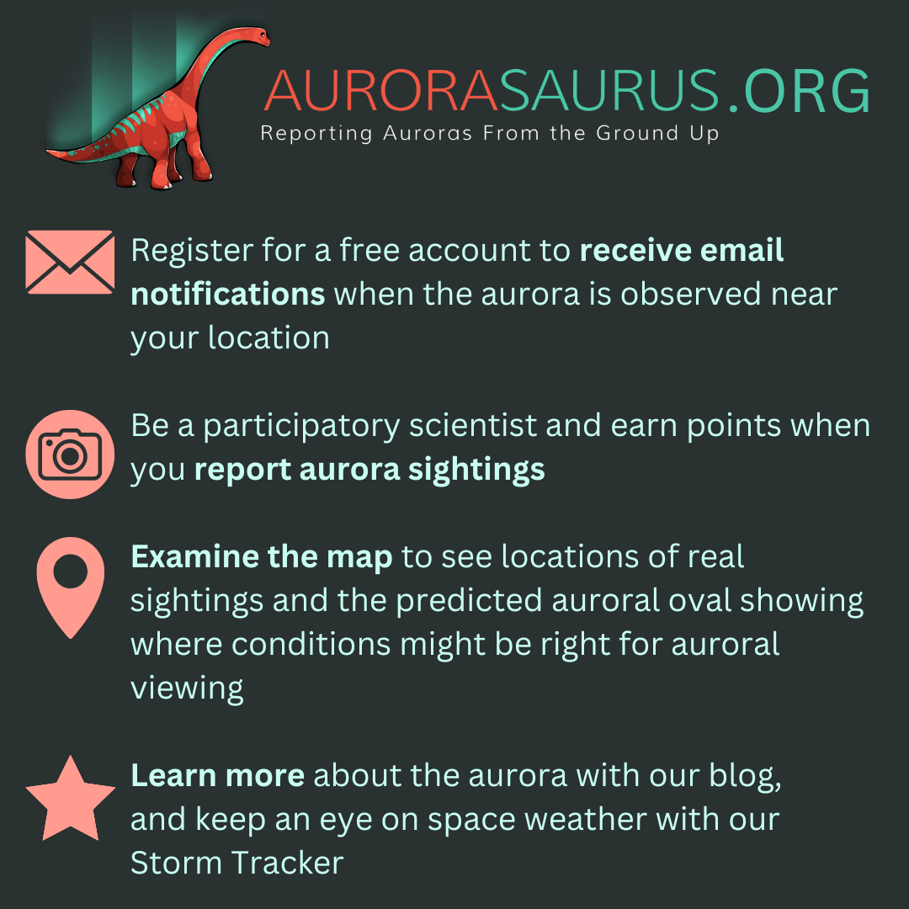
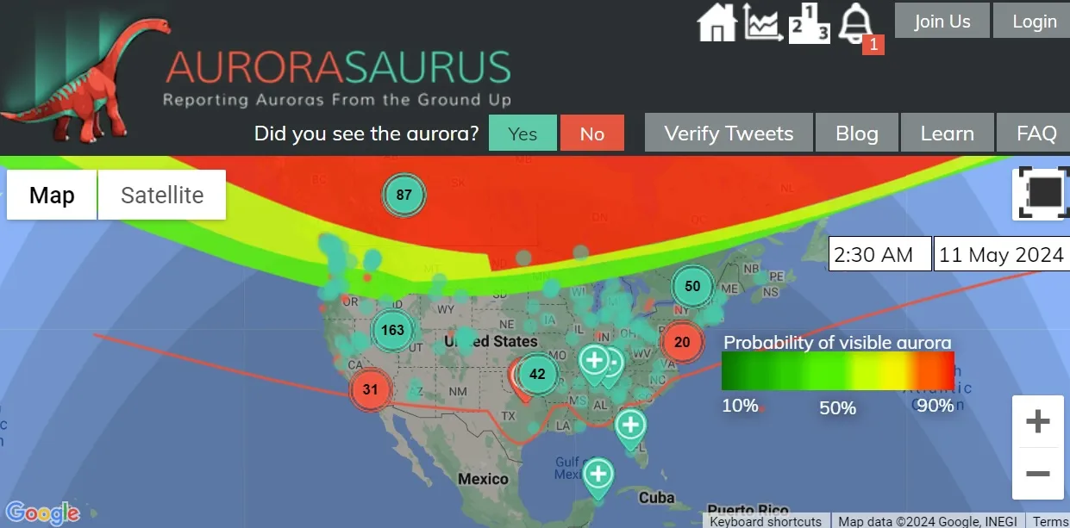
"Aurorasaurus made all the difference for me. I was able to see [the aurora] in Oakland, CA, and knew it was coming based upon user data in Reno." Damon T
Since 2014
Resources for educators here: https://infiniscope.org/page/aurorasaurus
(location, time, terms of use are required)
Users in Texas and Alabama received special alerts generated by nearby Aurorasaurus reporters

Slide 3
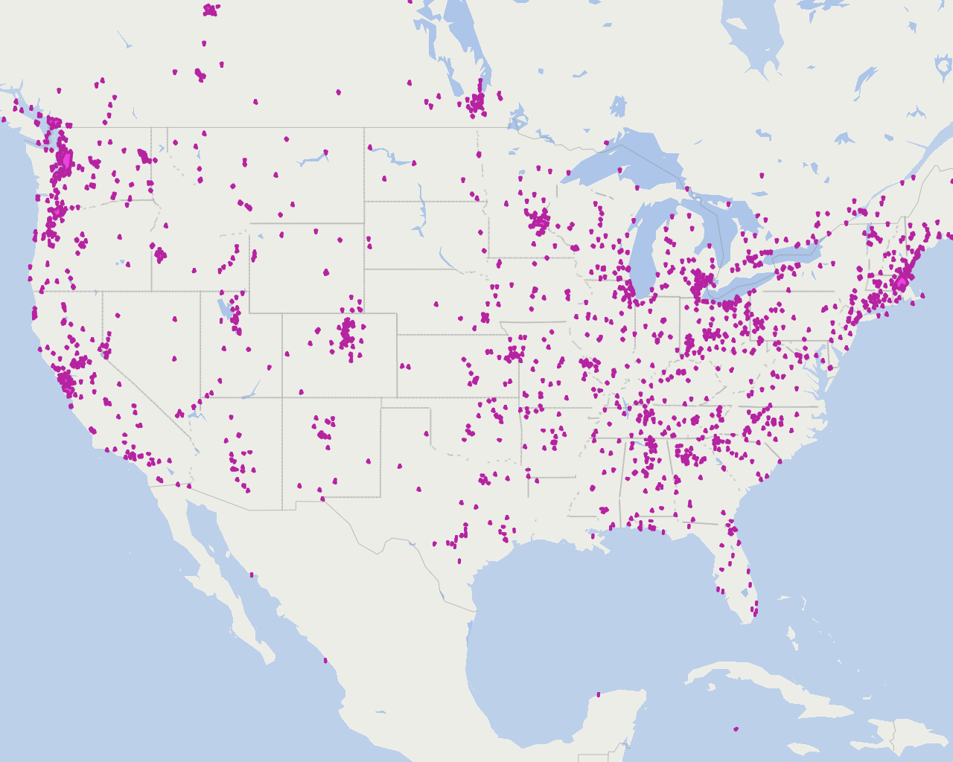
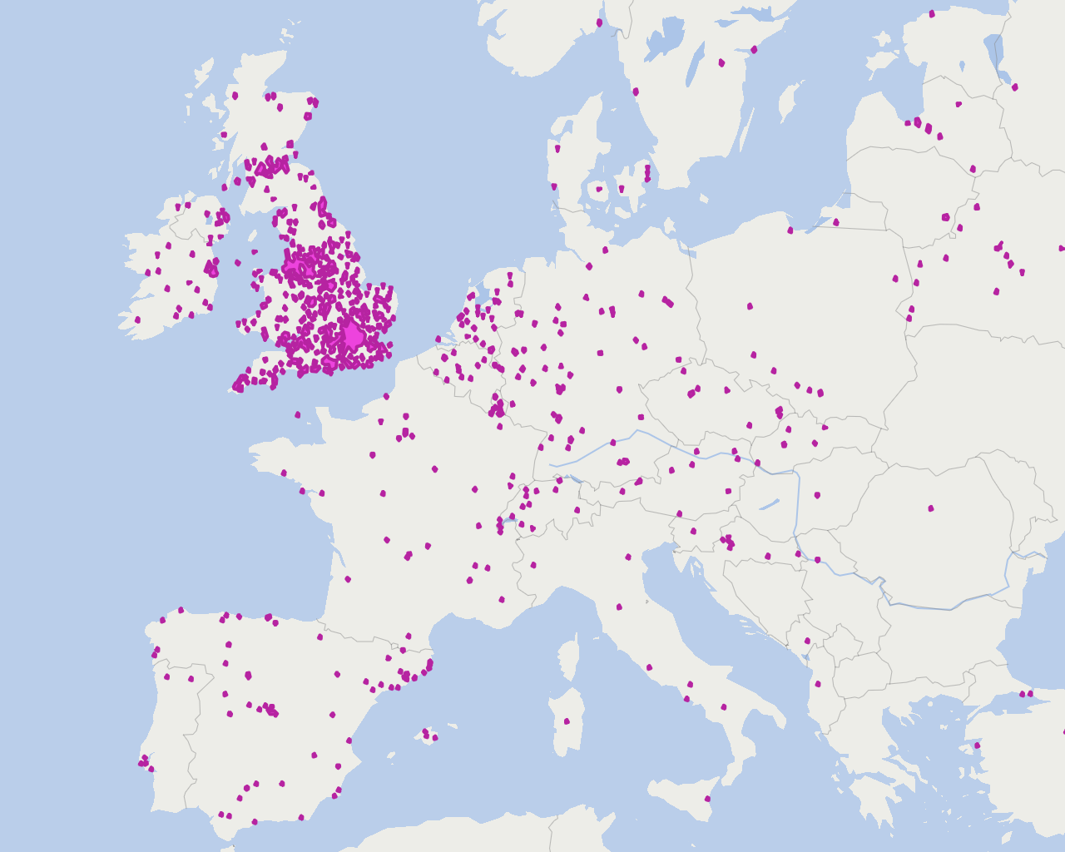
Aurorasaurus
Data
Around 4,000 people submitted aurora observations during the extreme May 2024 geomagnetic storm to Aurorasaurus.org, which uses the information for scientific research.
Source: Aurorasaurus
TIM MEKO AND KASHA PATEL / THE WASHINGTON POST
Includes precise times, locations, digital photos (optional), form responses (including color, type, activity level, location in the sky), and freeform comments.
Subject to terms of use, generally available for scientific collaboration with us, IRB approved and protections in place
Not completely open, as appropriate for citizen scientist images
Data validation, cleaning, and release of anonymized data for this new event is in process
Contact us at aurorasaurus.info@gmail.com
Notes:
https://wapo.st/4aITdSx
What is special about the UK? A powerhouse of reports!
Tracking with population.

Slide 4
Aurorasaurus past results apply to future work on extreme events
In 2015 we showed tweets track activity scaling with the size of the storm -> not surprised with the massive response to this large event. Case, N. A., et al., (2015). Mapping auroral activity with Twitter. Geophysical Research Letters, 42(10), 3668-3676. https://doi.org/https://doi.org/10.1002/2015GL063709
We built Aurorasaurus website to scale, collect reports robustly (with terms of use, time, location, photo, and simple information), and give free location-based alerts. Further website modernization tools are planned. Naked eye reports should be distinguished. MacDonald, E. A., et al., (2015). Aurorasaurus: A citizen science platform for viewing and reporting the aurora. Space Weather, 13(9), 548-559. https://doi.org/https://doi.org/10.1002/2015SW001214
We have used participatory reports to document the equatorial boundary. In 2015 we showed user reports further equatorward than the estimated view line. We modified our view line, and built the capacity to adapt even more. In 2024, clusters created in Texas and Florida, responses can be analyzed further. Case, N. A., Kingman, D., & MacDonald, E. A. (2016). A real-time hybrid aurora alert system: Combining citizen science reports with an auroral oval model. Earth and Space Science, 3(6), 257-265. https://doi.org/https://doi.org/10.1002/2016EA000167 Case, N. A., MacDonald, E. A., & Viereck, R. (2016). Using citizen science reports to define the equatorial extent of auroral visibility. Space Weather, 14(3), 198-209. https://doi.org/https://doi.org/10.1002/2015SW001320
Also, we compared equatorial boundary from 2 models, with people’s reports as ‘ground-truth’. Work in progress to update with new models, machine learning, as well as in a historical context. Kosar, B. C., et al., (2018b). A case study comparing citizen science aurora data with global auroral boundaries derived from satellite imagery and empirical models Journal of Atmospheric and Solar-Terrestrial Physics, 177, 274-282. https://doi.org/https://doi.org/10.1016/j.jastp.2018.05.006
In 2018, we published about STEVE, the optical manifestation of an extreme SAID. New discoveries to come, e.g. red aurora blog post trying to communicate cutting edge research and motivate reports. MacDonald, E. A., et al., (2018). New science in plain sight: Citizen scientists lead to the discovery of optical structure in the upper atmosphere. Science Advances, 4(3), eaaq0030. https://doi.org/doi:10.1126/sciadv.aaq0030
In 2018, we published open cleaned dataset. Planning to do so for HBY period pushing boundaries of open data in MOOC. Kosar, B. C., et al., (2018). Aurorasaurus Database of Real-Time, Crowd-Sourced Aurora Data for Space Weather Research. Earth and Space Science, 5(12), 970-980. https://doi.org/https://doi.org/10.1029/2018EA000454
Beginning back in ~2020, we started talking about the massive imaging potential for this solar max with cell phones -> After the Gannon storm, we realized, we had not even imaged a superstorm with digital cameras since the last were in 2003.
If you are interested in working on extending these results, please contact me. Liz MacDonald (e.a.macdonald@nasa.gov)
Notes:
Another way to say this, Gannon superstorm demonstrates (10x) the power of digital cameras to track aurora and boundaries.
Could also be a whole timeline of Educational Results & Collabs too
Future work:
Analysis of forms, e.g. document of SAR arc, red aurora, boundaries (from corona tracking)
Stitching of photos at scales
Cluster algorithm accuracy and people’s response to be analyzed

Slide 5
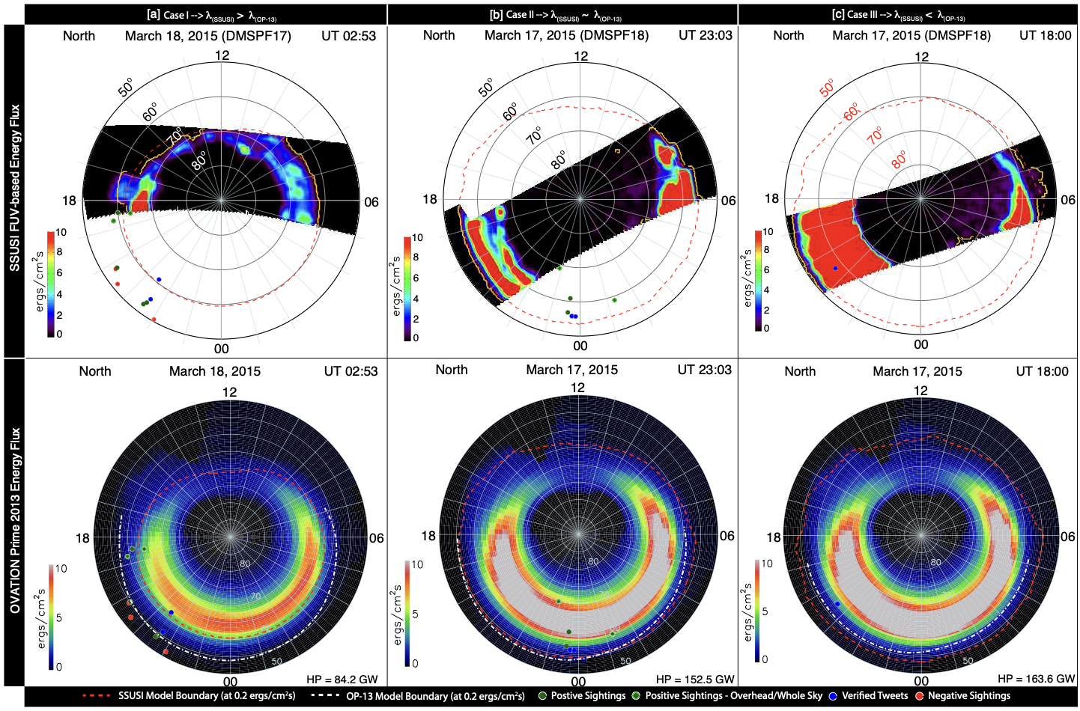
Kosar et al., 2018

Slide 6
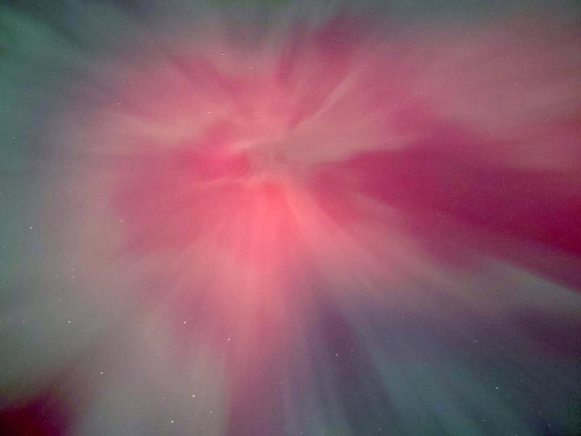
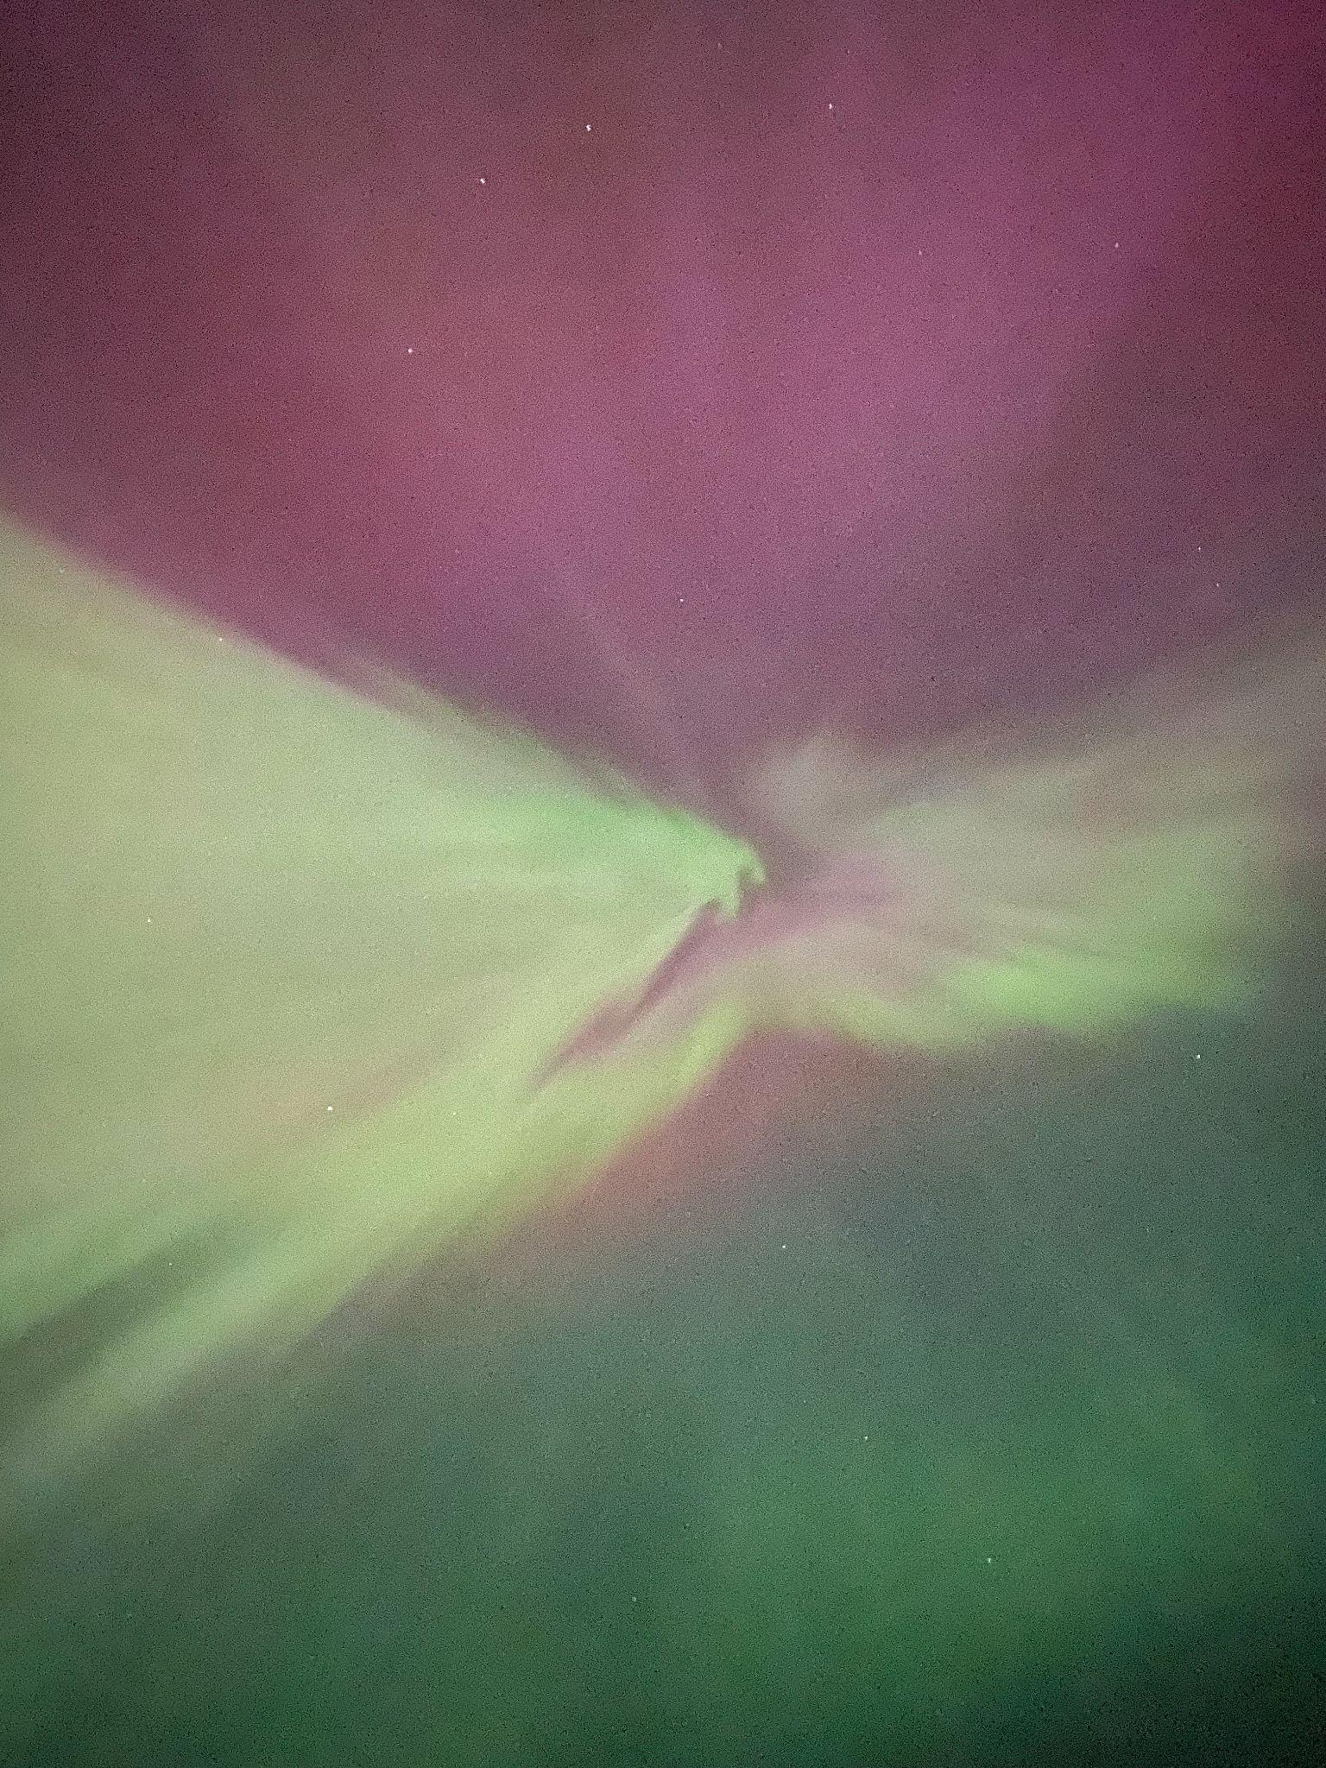
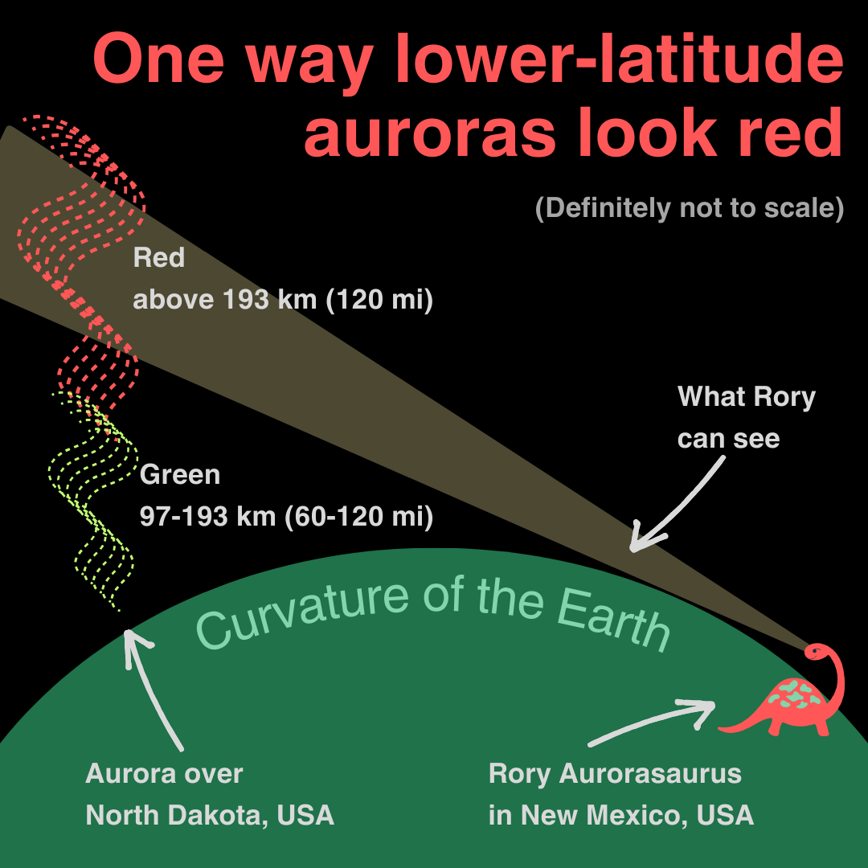
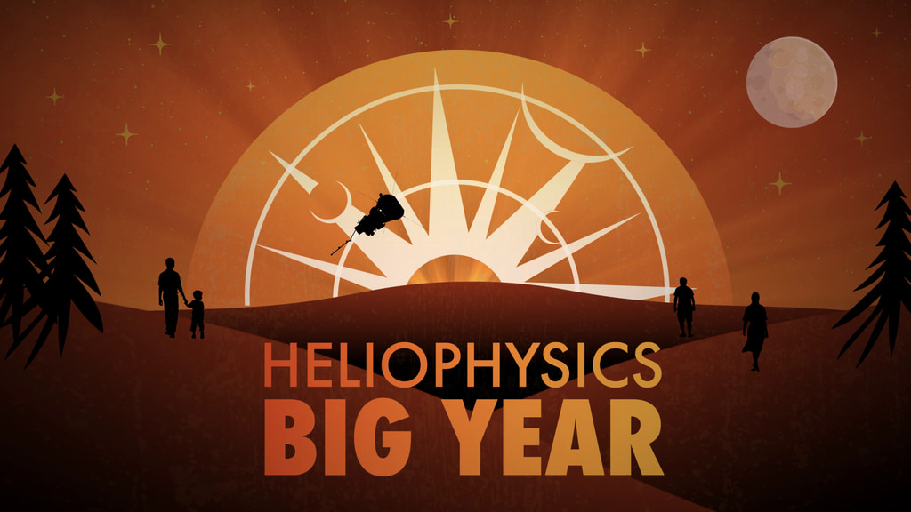
Have we ever fully imaged a storm?
Jaynes, NZ, 5/11/24
What is that red aurora? Might be multiple things!
High altitude red aurora, great red aurora, SAR arcs, equatorial airglow (He et al., 2020).
Cameras are so sensitive they can fool us. The eye is 5x more sensitive to green than red. How sensitive are today’s cameras and phones? Mini color night vision!
N
MacDonald, WA, iPhone 11 “Night mode” pic converted to JPEG
Helio Big Year Solar Max campaign aims to bring together the Heliophysics System Observatory, open science, citizen scientists and more (POC: Janet Kozyra) - stay tuned
Plain language descriptions help. https://blog.aurorasaurus.org/?p=2030
Notes:
Why didn’t this storm have Great red aurora?
How to map out the SAR arcs by combining heterogenous data.

Slide 7
OpenSpace Collaboration in Progress
Pros
Unique global 3d view, layering (clouds, DNB, etc)
Zooming in to show photos. Playing movies.
Exporting to planetariums.
Cons
Limited use of the platform, non-trivial to add features, photo stitching would happen outside OpenSpace
Must protect photographer’s photos and work out collaboration terms
Not clear who is the audience we should build the tool for/with. Solar Max scientists, citizen scientists, teachers. Each are potential users, but with some barriers. (versatility could also be a pro?)
Jaynes, NZ, 5/11/24
Notes:
This slide could be reworked into not pros/cons per se, but a series of statements
(not easy to add pieces onto, compared to other map products)

Slide 8
Backup slides with more visuals & talking points
Work in progress

Slide 9
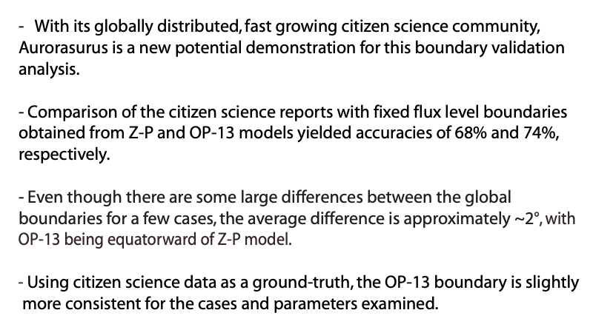
Kosar et al., 2018
Kosar and MacDonald, CCMC workshop 2017

Slide 10
Aurorasaurus Data
Includes precise times, locations, photos (optional), form responses, and freeform comments.
Subject to terms of use, generally available for collaboration with scientific community, IRB approved and protections in place
Not completely open, as appropriate for citizen scientist images
Data validation, cleaning, and release of anonymized data for this new event is in process
Contact us at aurorasaurus.info@gmail.com
Notes:
Questions:
Add check box for open license…
MOU’s with some collaborators like OpenSpace
DOI and Rules of the Road for usage of the dataset

Slide 11
Full Bibliography
Lalone, N., Tapia, A., Case, N., MacDonald, E., & Heavner, M. (2015). Hybrid Community Participation In Crowdsourced Early Warning Systems ISCRAM 2015 Conference Proceedings 12th International Conference on Information Systems for Crisis Response and Management, https://idl.iscram.org/files/nicklalone/2015/1270_NickLaLone_etal2015.pdf
LaLone, N., Tapia, A., MacDonald, E., Case, N., Hall, M., Clayton, J., & Heavner, M. J. (2015). Harnessing Twitter and Crowdsourcing to Augment Aurora Forecasting Proceedings of the 18th ACM Conference Companion on Computer Supported Cooperative Work & Social Computing, Vancouver, BC, Canada. https://doi.org/10.1145/2685553.2702671
Ledvina, V., Brandt, L., MacDonald, E., Frissell, N., Anderson, J., Chen, T. Y., . . . Sinha, G. (2023). Agile collaboration: Citizen science as a transdisciplinary approach to heliophysics [Perspective]. Frontiers in Astronomy and Space Sciences, 10. https://doi.org/10.3389/fspas.2023.1165254
Ledvina, V. E. (2023). Agile Collaboration: Citizen Science as a Transdisciplinary Approach to Heliophysics. In L. Brandt, E. MacDonald, N. Frissell, J. Anderson, T. Chen, R. French, F. Di Mare, A. Grover, K. Battams, K. Sigsbee, B. Gallardo-Lacourt, D. Lach, J. Shaw, M. Hunnekuhl, B. Kosar, W. Barkhouse, T. Young, C. Kedhambadi, D. S. Ozturk, S. G. Claudepierre, C. Dong, A. Witteman, J. Kuzub, E. Palmeiro, & G. Sinha (Eds.): White Paper submitted to the Heliophysics 2024–2033 Decadal Survey.
Ledvina, V. E., McGranaghan, R. M., Palmerio, E., Halford, A. J., Brandt, L., Thayer, A., . . . Kuzub, J. (2023). How Open Data and Interdisciplinary Collaboration Improve Our Understanding of Space Weather: A Risk & Resiliency Perspective. In: White Paper submitted to the Heliophysics 2024–2033 Decadal Survey.
Ledvina, V. E., Palmerio, E., McGranaghan, R. M., Halford, A. J., Thayer, A., Brandt, L., . . . Kuzub, J. (2022). How open data and interdisciplinary collaboration improve our understanding of space weather: A risk and resiliency perspective [Perspective]. Frontiers in Astronomy and Space Sciences, 9. https://doi.org/10.3389/fspas.2022.1067571
MacDonald, E. (2018). STEVE and the Citizen Scientists [Article]. American Scientist, 106, 283+.
MacDonald, E., Halford, A., Ledvina, V., Rowland, D., Ozturk, D., di Mare, F., . . . Ridley, A. (2023). Science for all: The case for Citizen Science in all NASA missions. In: White Paper submitted to the Heliophysics 2024–2033 Decadal Survey.
MacDonald, E. A., Case, N. A., Clayton, J. H., Hall, M. K., Heavner, M., Lalone, N., . . . Tapia, A. (2015). Aurorasaurus: A citizen science platform for viewing and reporting the aurora. Space Weather, 13(9), 548-559. https://doi.org/https://doi.org/10.1002/2015SW001214
MacDonald, E. A., Donovan, E., Nishimura, Y., Case, N. A., Gillies, D. M., Gallardo-Lacourt, B., . . . Schofield, I. (2018). New science in plain sight: Citizen scientists lead to the discovery of optical structure in the upper atmosphere. Science Advances, 4(3), eaaq0030. https://doi.org/doi:10.1126/sciadv.aaq0030
Semeter, J., Hunnekuhl, M., MacDonald, E., Hirsch, M., Zeller, N., Chernenkoff, A., & Wang, J. (2020). The Mysterious Green Streaks Below STEVE. AGU Advances, 1(4), e2020AV000183. https://doi.org/https://doi.org/10.1029/2020AV000183
Tapia, A., LaLone, N., MacDonald, E., Hall, M., Case, N., & Heavner, M. (2014). AURORASAURUS: Citizen Science, Early Warning Systems and Space Weather. Proceedings of the AAAI Conference on Human Computation and Crowdsourcing, 2(1), 30-32. https://doi.org/10.1609/hcomp.v2i1.13212
Tapia, A. H., Lalone, N., MacDonald, E. A., Priedhorsky, R., & Hall, M. (2014). Crowdsourcing rare events: Using curiosity to draw participants into science and early warning systems. International Conference on Information Systems for Crisis Response and Management.
Case, N. A., Kingman, D., & MacDonald, E. A. (2016). A real-time hybrid aurora alert system: Combining citizen science reports with an auroral oval model. Earth and Space Science, 3(6), 257-265. https://doi.org/https://doi.org/10.1002/2016EA000167
Case, N. A., & MacDonald, E. A. (2015). Aurorasaurus and the St Patrick's Day storm. Astronomy & Geophysics, 56(3), 3.13-13.14. https://doi.org/10.1093/astrogeo/atv089
Case, N. A., MacDonald, E. A., Heavner, M., Tapia, A. H., & Lalone, N. (2015). Mapping auroral activity with Twitter. Geophysical Research Letters, 42(10), 3668-3676. https://doi.org/https://doi.org/10.1002/2015GL063709
Case, N. A., MacDonald, E. A., McCloat, S., Lalone, N., & Tapia, A. (2016). Determining the Accuracy of Crowdsourced Tweet Verification for Auroral Research. Citizen Science: Theory and Practice. https://doi.org/10.5334/cstp.52
Case, N. A., MacDonald, E. A., & Viereck, R. (2016). Using citizen science reports to define the equatorial extent of auroral visibility. Space Weather, 14(3), 198-209. https://doi.org/https://doi.org/10.1002/2015SW001320
Edson, L. B., MacDonald, E., Fischer, H., & Cawood, A. (2024). Practical Applications of a Participatory Science Project Evaluation Tool: Perspectives from Across Earth and Space Science Citizen Science: Theory and Practice, 9(1), 10. https://doi.org/10.5334/cstp.536
Frissell, N. A., Ackermann, J. R., Alexander, J. N., Benedict, R. L., Blackwell, W. C., Boedicker, R. K., . . . Yadav, N. (2023). Heliophysics and amateur radio: citizen science collaborations for atmospheric, ionospheric, and space physics research and operations [Review]. Frontiers in Astronomy and Space Sciences, 10. https://doi.org/10.3389/fspas.2023.1184171
Hunnekuhl, M., & MacDonald, E. (2020). Early Ground-Based Work by Auroral Pioneer Carl Størmer on the High-Altitude Detached Subauroral Arcs Now Known as “STEVE”. Space Weather, 18(3), e2019SW002384. https://doi.org/https://doi.org/10.1029/2019SW002384
Kosar, B. C., MacDonald, E. A., Case, N. A., & Heavner, M. (2018). Aurorasaurus Database of Real-Time, Crowd-Sourced Aurora Data for Space Weather Research. Earth and Space Science, 5(12), 970-980. https://doi.org/https://doi.org/10.1029/2018EA000454
Kosar, B. C., MacDonald, E. A., Case, N. A., Zhang, Y., Mitchell, E. J., & Viereck, R. (2018b). A case study comparing citizen science aurora data with global auroral boundaries derived from satellite imagery and empirical models Journal of Atmospheric and Solar-Terrestrial Physics, 177, 274-282. https://doi.org/https://doi.org/10.1016/j.jastp.2018.05.006
LaLone, N., & Tapia, A. (2016). Three lessons from aurorasaurus about public facing information system design. In V. A. B. S. Pedro Antunes, Andrea H. Tapia, Kathleen Ann Moore, João Porto de Albuquerque, ISCRAM 2016 Conference Proceedings - 13th International Conference on Information Systems for Crisis Response and Management 13th International Conference on Information Systems for Crisis Response and Management, ISCRAM 2016, Rio de Janeiro, Brazil.

